Slide 1

Introduction to
SEN provision at
Englefield C E Primary School
Sowing the seeds for a flourishing future

Slide 2


Slide 3
Who’s who?
Miss Langston – SENCo
Mrs Smith – Intervention teaching assistant
Mrs Rose and Mrs Hough – one to one TAs
Mrs Harwood, Miss Kemp, Mrs Newsome, Mrs Jackson and Mrs Kelley are class TAs often with an area of expertise in supporting pupils in various ways
Who is ultimately responsible for your child’s progress?
Your child’s class teacher (with support from the SENCo and the Strategic Leadership Team)

Slide 4
What support is provided?
In class ordinarily available provision
Quality first teaching – class teachers employ a range of strategies and adaptive teaching methods to suit all learners.
Teachers and teaching assistants have received a variety of training in supporting pupils with additional needs eg dyslexia friendly classroom, strategies to support autistic pupils, identifying pupils with dyspraxia and using materials to support maths learning
Equipment to support learning- fiddle toys, wobble cushions, pen grips, coloured paper, seating arrangements, personalised learning
Movement breaks
Small group support with class TA in core subjects
Additional support offered eg STAR reading, ELSA, SNIP, NESSY, SNAP maths
Your child may have a GAP (Graduated Approach Plan)

Slide 5
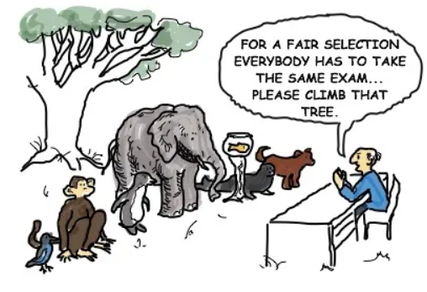

Slide 6
What if my child is not making progress?
If QFT and reasonable adaptations are not supporting your child to make progress they may require provision that is ‘additional to’ or ‘different from’ their peers. (SEN Code of Practice, 2014)
SAP will be written
Pupils are on the SEN register
Progress is monitored through termly assessment
Interventions are given (start and end data and record of intervention kept, liaison with class teacher and SENco)

Slide 7


Slide 8
What interventions are provided?
Speech and language sessions
Zones of regulation sessions
ELSA
Socially speaking
Building blocks
SNAP on to maths
Plus one maths
SNIP spelling
Nessy spelling, reading and fingers
Homunculi
STAR reading
Morphology spelling sessions
Keeping a broad and balanced curriculum is important to us and your child so we only withdraw for extra support if we feel it is appropriate.

Slide 9
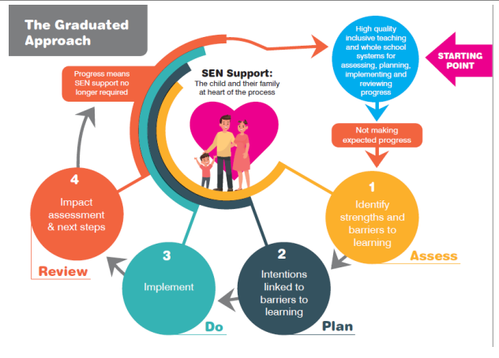

Slide 10
What if interventions do not lead to progress?
We seek advice from professionals
CYPIT Speech and Language Therapists and Occupational Therapists
CALT (Cognition and Learning Team)
Autism Team at West Berks
Educational Psychologist
CAMHs
Therapeutic Thinking Team
Emotional Health Academy
Other SENCos and headteachers

Slide 11
Your views are important
Please contact your child’s class teacher as a first point of contact
Please do contact me as SENCo /Mrs Latimer as HT if necessary
Please reach out for help if you need it – if we don’t know the answer, we can find out or find someone who does
Complete questionnaire either now or drop it into office
What would be interesting for you next time we meet?

Slide 12
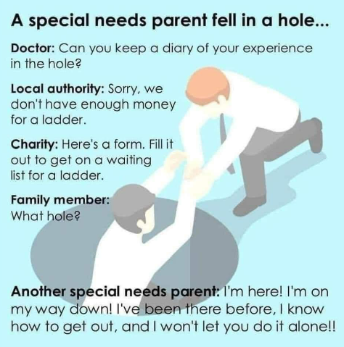
Sometimes only someone in the same position can truly help / understand
Would you like to exchange numbers and make a WhatsApp group? Or have a support group email?

